Slide 1
HR Analytics Job Change of Data Scientists
Under Supervision of Eng. Abelrahman Gaber
Prepared by: Moustafa Samir

Slide 2
About the dataset
A company which is active in Big Data and Data Science wants to hire data scientists among people who successfully pass some courses which conduct by the company. Many people signup for their training. Company wants to know which of these candidates are really wants to work for the company after training or looking for a new employment because it helps to reduce the cost and time as well as the quality of training or planning the courses and categorization of candidates. Information related to demographics, education, experience are in hands from candidates signup and enrollment.

Slide 3

About the dataset
This dataset designed to understand the factors that lead a person to leave current job for HR researches too. By model(s) that uses the current credentials, demographics, experience data you will predict the probability of a candidate to look for a new job or will work for the company, as well as interpreting affected factors on employee decision.
Dataset is split in three files 1>> train, 2>> test without result & 3>> result only for the test data
Dataset contains 21,287 rows & 14 columns before cleaning

Slide 4
Columns
enrollee_id : Unique ID for candidate.
city: City code.
city_ development _index : Developement index of the city (scaled).
gender: Gender of candidate
relevent_experience: Relevant experience of candidate
enrolled_university: Type of University course enrolled if any
education_level: Education level of candidate
major_discipline :Education major discipline of candidate
experience: Candidate total experience in years
company_size: No of employees in current employer's company
company_type : Type of current employer
last_new_job: Difference in years between previous job and current job
training_hours: training hours completed
target: 0 – Not looking for job change, 1 – Looking for a job change

Slide 5
Data Info
RangeIndex: 21287 entries, 0 to 21286
Data columns (total 14 columns):
# Column Non-Null Count Dtype
--- ------ -------------- -----
0 enrollee_id 21287 non-null int64
1 city 21287 non-null object
2 city_development_index 21287 non-null float64
3 gender 16271 non-null object
4 relevent_experience 21287 non-null object
5 enrolled_university 20870 non-null object
6 education_level 20775 non-null object
7 major_discipline 18162 non-null object
8 experience 21217 non-null object
9 company_size 14727 non-null object
10 company_type 14513 non-null object
11 last_new_job 20824 non-null object
12 training_hours 21287 non-null int64
13 target 21287 non-null float64
dtypes: float64(2), int64(2), object(10)
memory usage: 2.3+ MB

Slide 6
Descriptive statsitcs
 | gender | relevent_experience | enrolled_university | education_level | major_discipline | experience | company_size | company_type | last_new_job | looking_for_job_change
count | 16271 | 21287 | 20870 | 20775 | 18162 | 21217 | 14727 | 14513 | 20824 | 19158
unique | 3 | 2 | 3 | 5 | 6 | 22 | 8 | 6 | 6 | 2
top | Male | Has relevent experience | no_enrollment | Graduate | STEM | >20 | 50-99 | Pvt Ltd | 1 | No
freq | 14681 | 15316 | 15336 | 12867 | 16113 | 3669 | 3421 | 10958 | 8924 | 14381
city_development_index training_hours target
count 21287.000000 21287.000000 21287.000000
mean 0.828462 65.328510 0.274416
std 0.123537 60.075201 0.417273
min 0.448000 1.000000 0.000000
25% 0.739000 23.000000 0.000000
50% 0.903000 47.000000 0.000000
75% 0.920000 88.000000 0.500000
max 0.949000 336.000000 1.000000

Slide 7
Missing values
city_development_index 0
gender 5016
relevent_experience 0
enrolled_university 417
education_level 512
major_discipline 3125
experience 70
company_size 6560
company_type 6774
last_new_job 463
training_hours 0
target 0
looking_for_job_change 2129
Duplicates:
62 duplicate rows

Slide 8
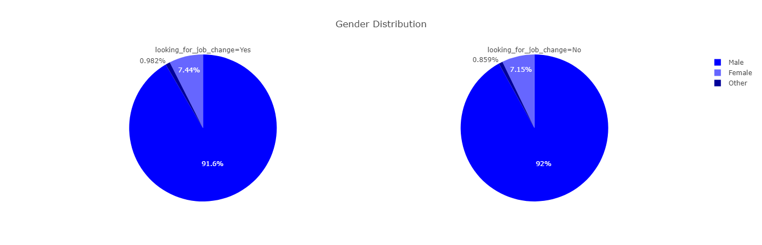
How Gender influence candidate to look for job change?

Slide 9
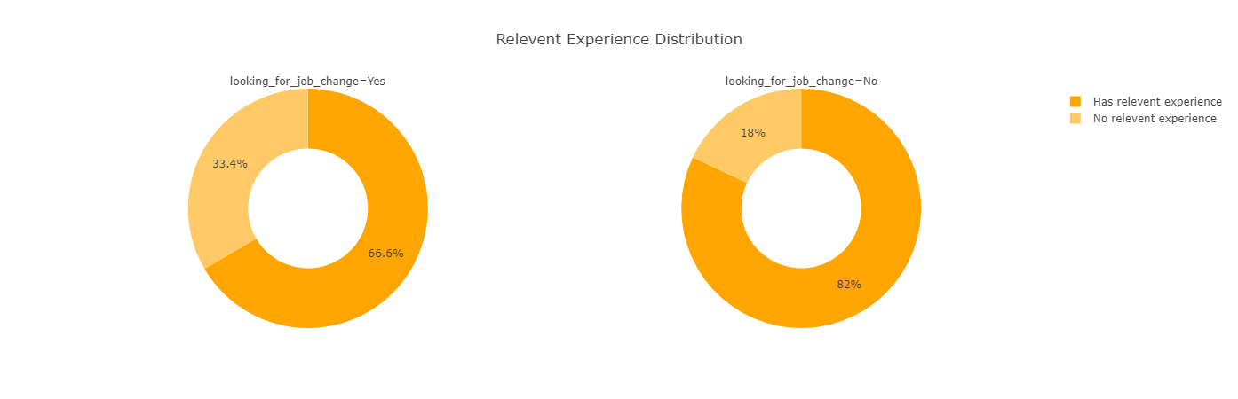
How Relevant experience influence candidate to look for job change?

Slide 10
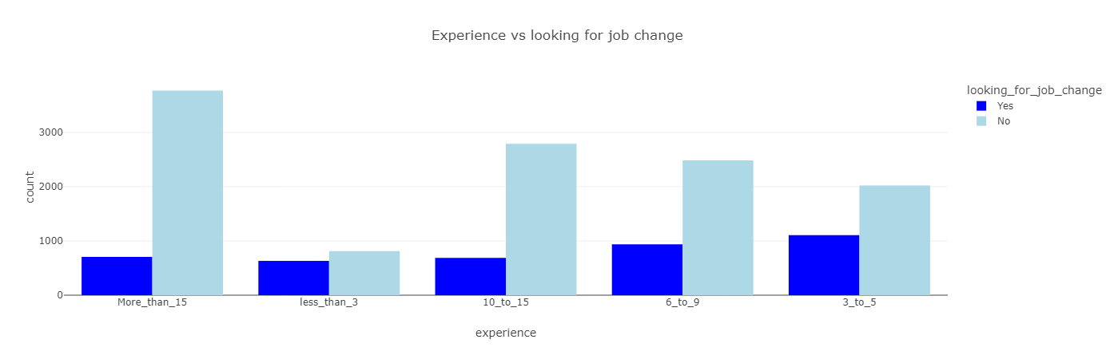
How Experience influence candidate to look for job change?

Slide 11
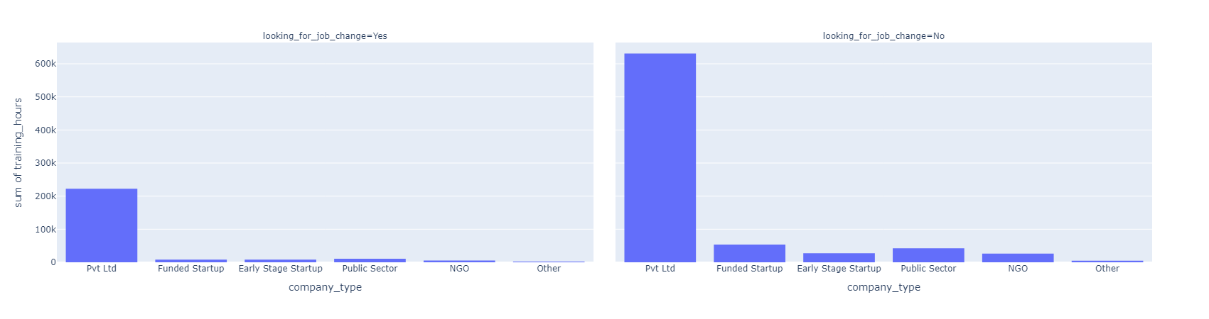
How company type influence candidate to look for job change?

Slide 12
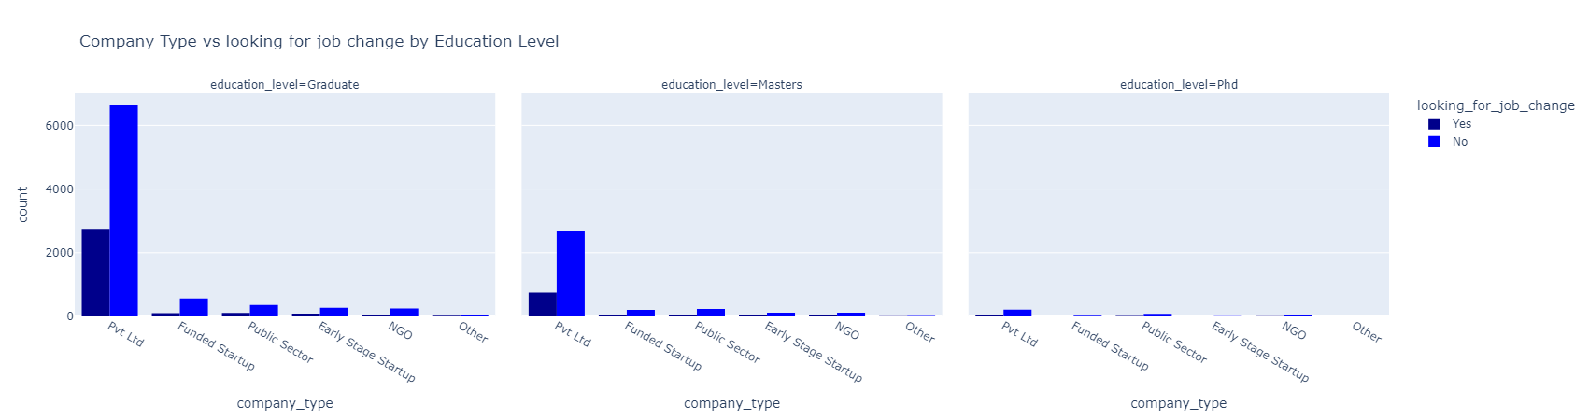
Company Type vs looking for job change by Education Level

Slide 13
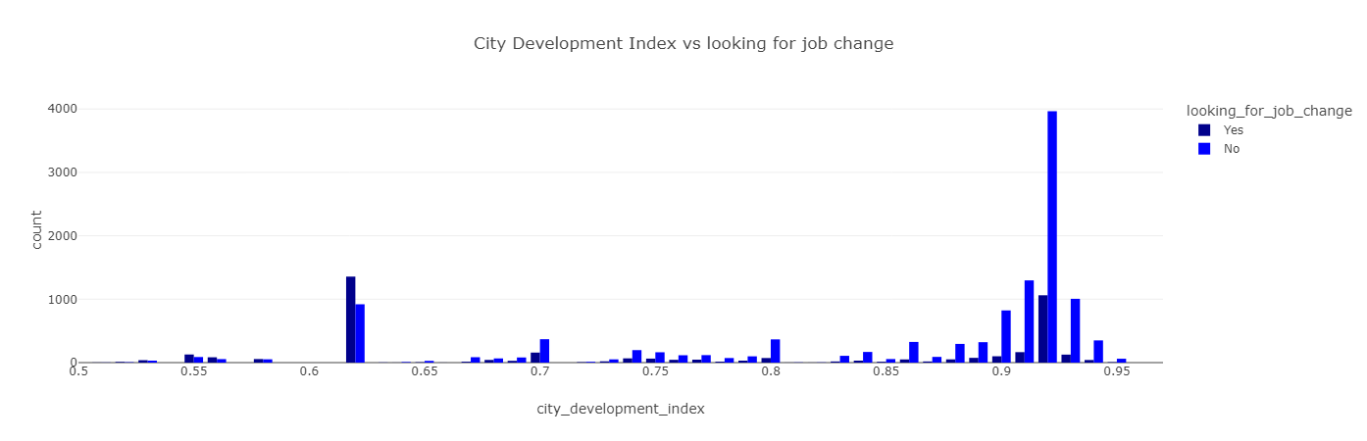
How City development index influence candidate to look for job change?

Slide 14
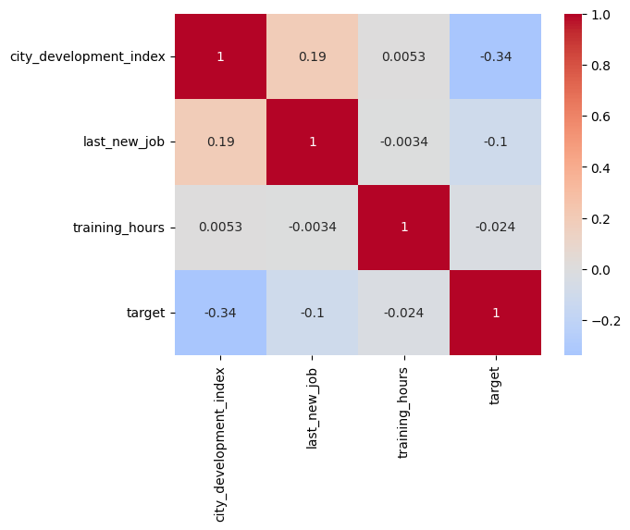
Heatmap

Slide 15
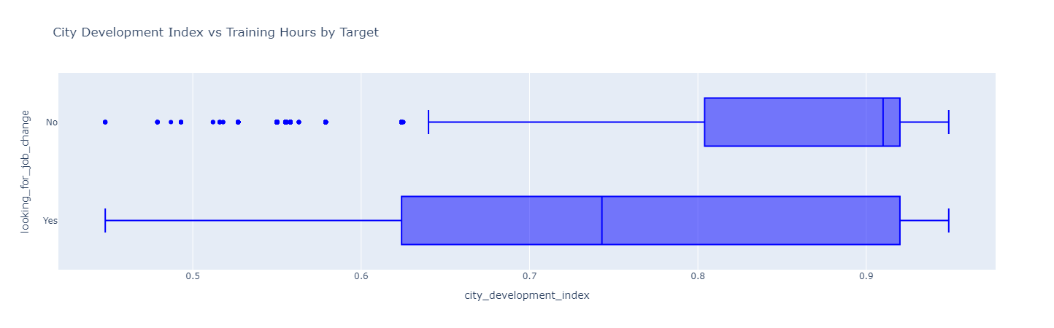
City development index vs looking for job change

Slide 16
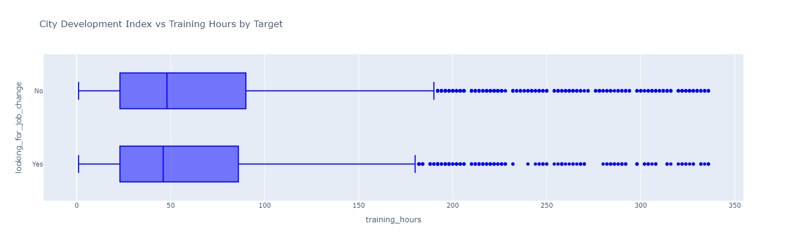
Training hours vs looking for job change

Slide 17
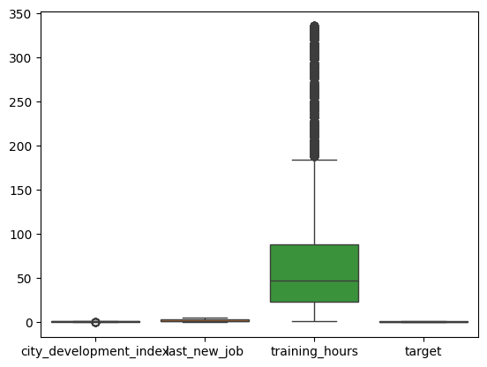
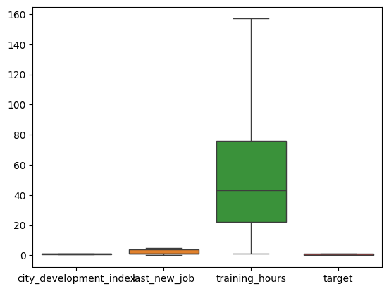
Dealing with outliers
Before
Before

Slide 18
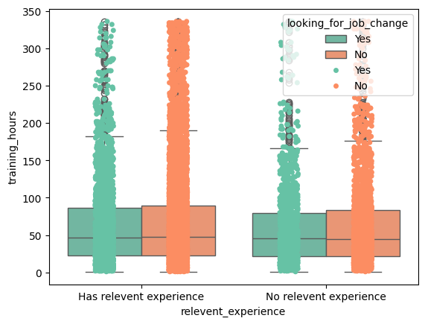
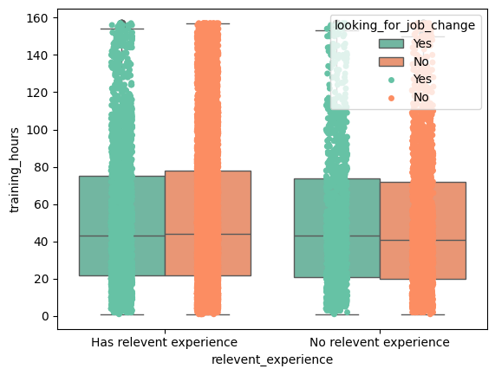
Dealing with outliers
Before
Before

Slide 19
Preprocessing
Handle missing data
Drop
Fill with mod
Dealing with categorical data:
Pandas (get_dummies)
One hot encoder
Label encoder
Handle outlier
Split data into X & Y
Split data into train & test
Scaling
Standard scaler
Handle imbalance data >>
Random under sampler
Cleaning data
Before RUS >>target
0.0 8697
1.0 3026
After RUS>>target
0.0 3026
1.0 3026

